Slide 1

Texas City FFA

Slide 2
Agriculture Science Courses Pathways
Freshman Year | Sophomore Year | Junior Year | Senior Year
Principles of Agriculture, Food and Natural Resources | Principles of Floral Design | Horticulture Science | Adv. Plant and Soil Science**
 | Equine Science/ Small Animal Management | Advanced Animal Science (Vet Med 1) | Practicum in Agriculture (VetMed 2) – 2 periods

Slide 3
Texas City FFA “No Pass, No Substitute” & Attendance Policy
Texas City FFA has implemented the “No Pass, No Substitute” policy starting with the 2014 Galveston County Fair and Rodeo. In the past, students who failed during the six weeks could have an eligible student substitute show their project at the fair. Texas City FFA will no longer have substitutes for students who are ineligible. If a student fails they will not be able to exhibit their animal at the Galveston County Fair. This is the same rule we abide by at all major shows- There are no substitutes allowed to show at any major show. Texas City FFA abides by the UIL “No Pass, No Play” rule. We will continue to strictly abide by that rule in our chapter. We encourage students to keep their grades up and come to school daily. We want all of our members passing their classes at all times during the school year.
**Parents: PLEASE check Home Access Center regularly to make sure your kid(s) are keeping up with their grades.**

Slide 4
Additionally, students who have scramble animals and are bound by the Houston Livestock Show and Rodeo or the Galveston County Fair to bring the animal back to show fail are liable for paying all scramble money back to HLSR &/or GCFR due to not being eligible to exhibit the animal.
Absences will be checked regularly for all FFA/JrFFA members. Students must following the following rules for attendance:
-No more than 8 unexcused absences per semester.
3 Tardies count as on unexcused absence.
- All absences must be documented.
- All documentation MUST be turned in to the school within 48 hours of being absent.
- An Assistant Principal must be contacted ASAP for extenuating circumstances and also communicated with an Ag Teacher.
Failure to comply with the attendance policy will be grounds for removal from Texas City FFA and animal project(s) from the TCISD Ag Facility.
**Entries for shows will be turned in after all required forms and fees are submitted to Mrs. Ashcraft.**

Slide 5
TCFFA Dues
TCFFA Dues will be $35.00 per member
dues are used to pay for:
  District Dues
  Area Dues
  State Dues
  Chapter T-Shirt
FFA Dues will need to be paid through Revtrak by September 27th

Slide 6

“What can I do in FFA?”
Leadership Development Events
Career Development Events
Supervised Agricultural Experiences
Talent Contest
Agriscience Fair
Speaking Development Events
FFA Rodeo
Chapter, District, Area, and State Office***
Community Service
**Letterman and Senior Cords Opportunities**

Slide 7
LDEs
(Leadership Development Events)
Mrs. Ashcraft | Ms Richards
Ag Issues Public Relations Ag Advocacy Greenhand Skills Senior Skills | Senior Creed Radio Broadcasting Senior Quiz
Ms Westhoff | Westhoff/ Richards
Greenhand Quiz Greenhand Creed | GH/ SR Spanish Creed GH/SR Chapter Conducting Job Interview

Slide 8


Shooting Team
Must complete the ducks unlimited ecological conservation & management certification
Must have/obtain hunter’s education certification.
Must be enrolled in an ag class at least 1 semester.
Must be an FFA member and is expected to attend FFA meetings.
Students are responsible for soliciting sponsors to offset competition expenses.
Students are responsible for practice costs.
Https://www.Facebook.Com/tchsshootingstings/

Slide 9
Livestock Show Team Requirements
If stalled in the barn, must have a signed barn contract turned in and stall fee(s) paid
Can be paid through RevTrak
Attend Chapter Meetings
Must pass ALL classes to participate
Barn Workdays Mandatory
First Monday of the month @6PM

Slide 10
Livestock Show Team Options
Market Steer
Breeding Heifer
Commercial Heifer
Pen of 3 Commercial Heifers
Market Swine
Market Lamb
Market Goat
Market Broilers and Turkeys
Single or Pen of 3 Rabbits
Galveston County Fair

Slide 11
Overview of Raising Animals
Barn available to house all animals
  besides Rabbits & Cavies
Cost of each animal species varies
Supervisor for each species
Limited stalling
Swine, Rabbits& Cavies | Lambs & Goats | Cattle & Poultry
Ms. Westhoff | Ms. Richards | Mrs. Ashcraft

Slide 12
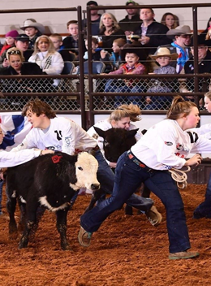
Calf Scramble
Purpose: Chance to earn a certificate towards the cost of a steer or heifer
Contact: Mrs. Ashcraft before Sep 27th
San Antonio Stock Show & Rodeo (February)
Houston Livestock Show & Rodeo (March)
Galveston County Fair & Rodeo (April)
  GCFR has additional meeting students MUST ATTEND
  You must reach out to the FFA Advisors to let them know you are signing up

Slide 13
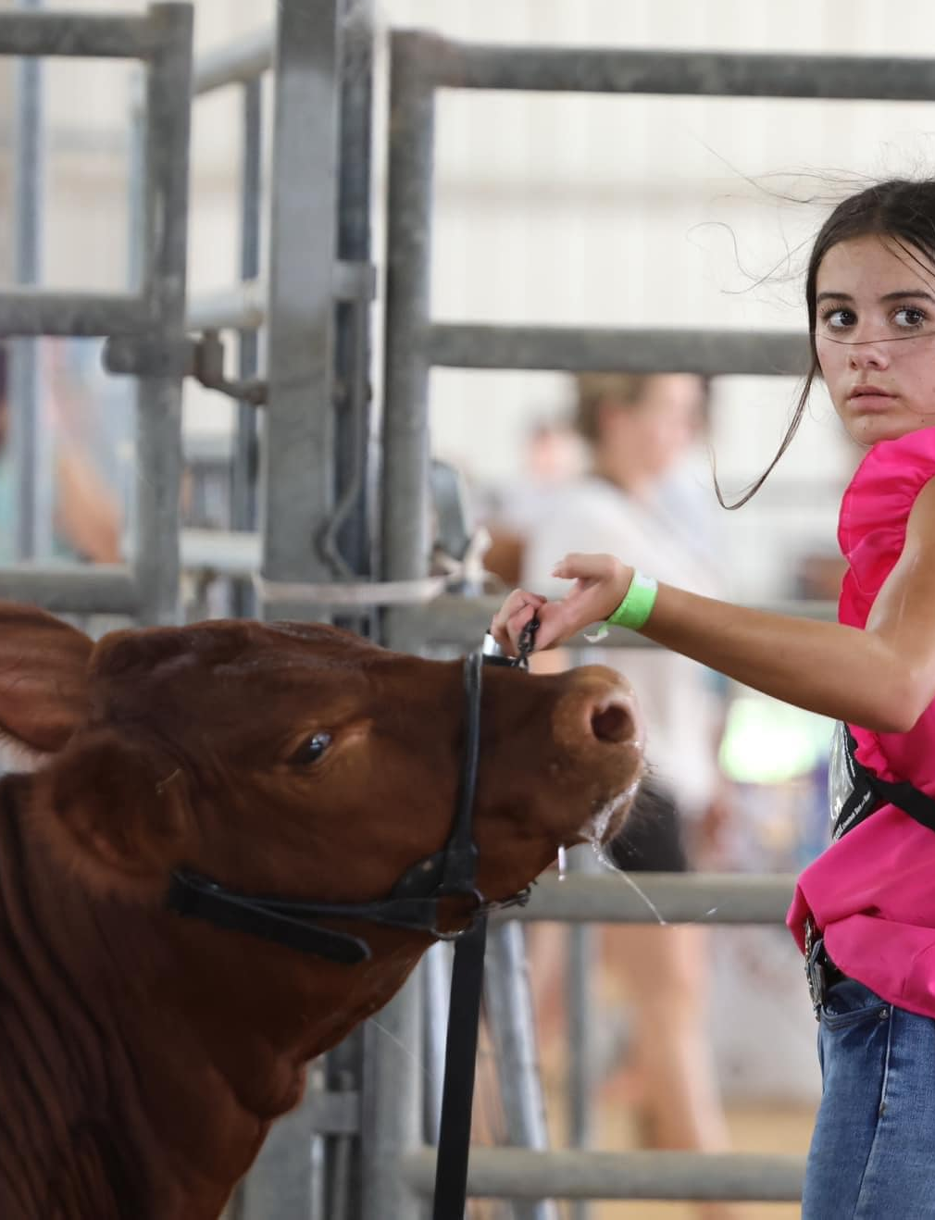
Cattle: Steers & Heifers
Timeframe: 9 month +
Purchase Cost: $2500 and up (varies)
Feed Cost: $200/ month AVERAGE
Contact: Mrs. Ashcraft
Animal is fed 2 times per day. (before and after school)
Animal’s stall is cleaned daily-All stalls must be clean and free of manure when an animal is let out at night.
Entry Fees vary depending upon show.

Slide 14
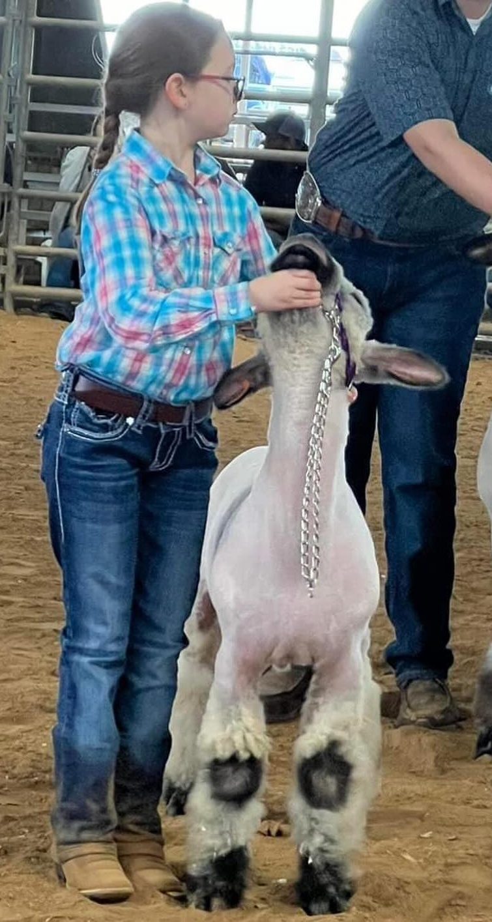
Lambs & Goats
Timeframe: 7-8 months
Purchase Cost: $500+
Feed Cost: $45/ month + (average)
Contact: Ms. Richards
The animal is fed 2 times per day. (before and after school)
Stall is cleaned AT LEAST weekly.
Entry Fees vary depending upon show.

Slide 15
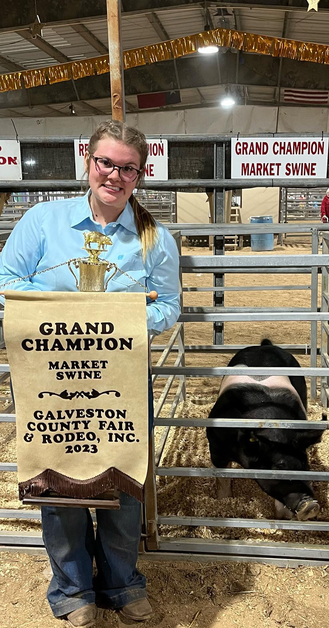
Pigs
Timeframe: 5 - 6 months
Purchase Cost: $450 +
Feed Cost: $200/ month
Contact: Miss Griffis
Animal stall is cleaned daily.
Entry Fees vary

Slide 16
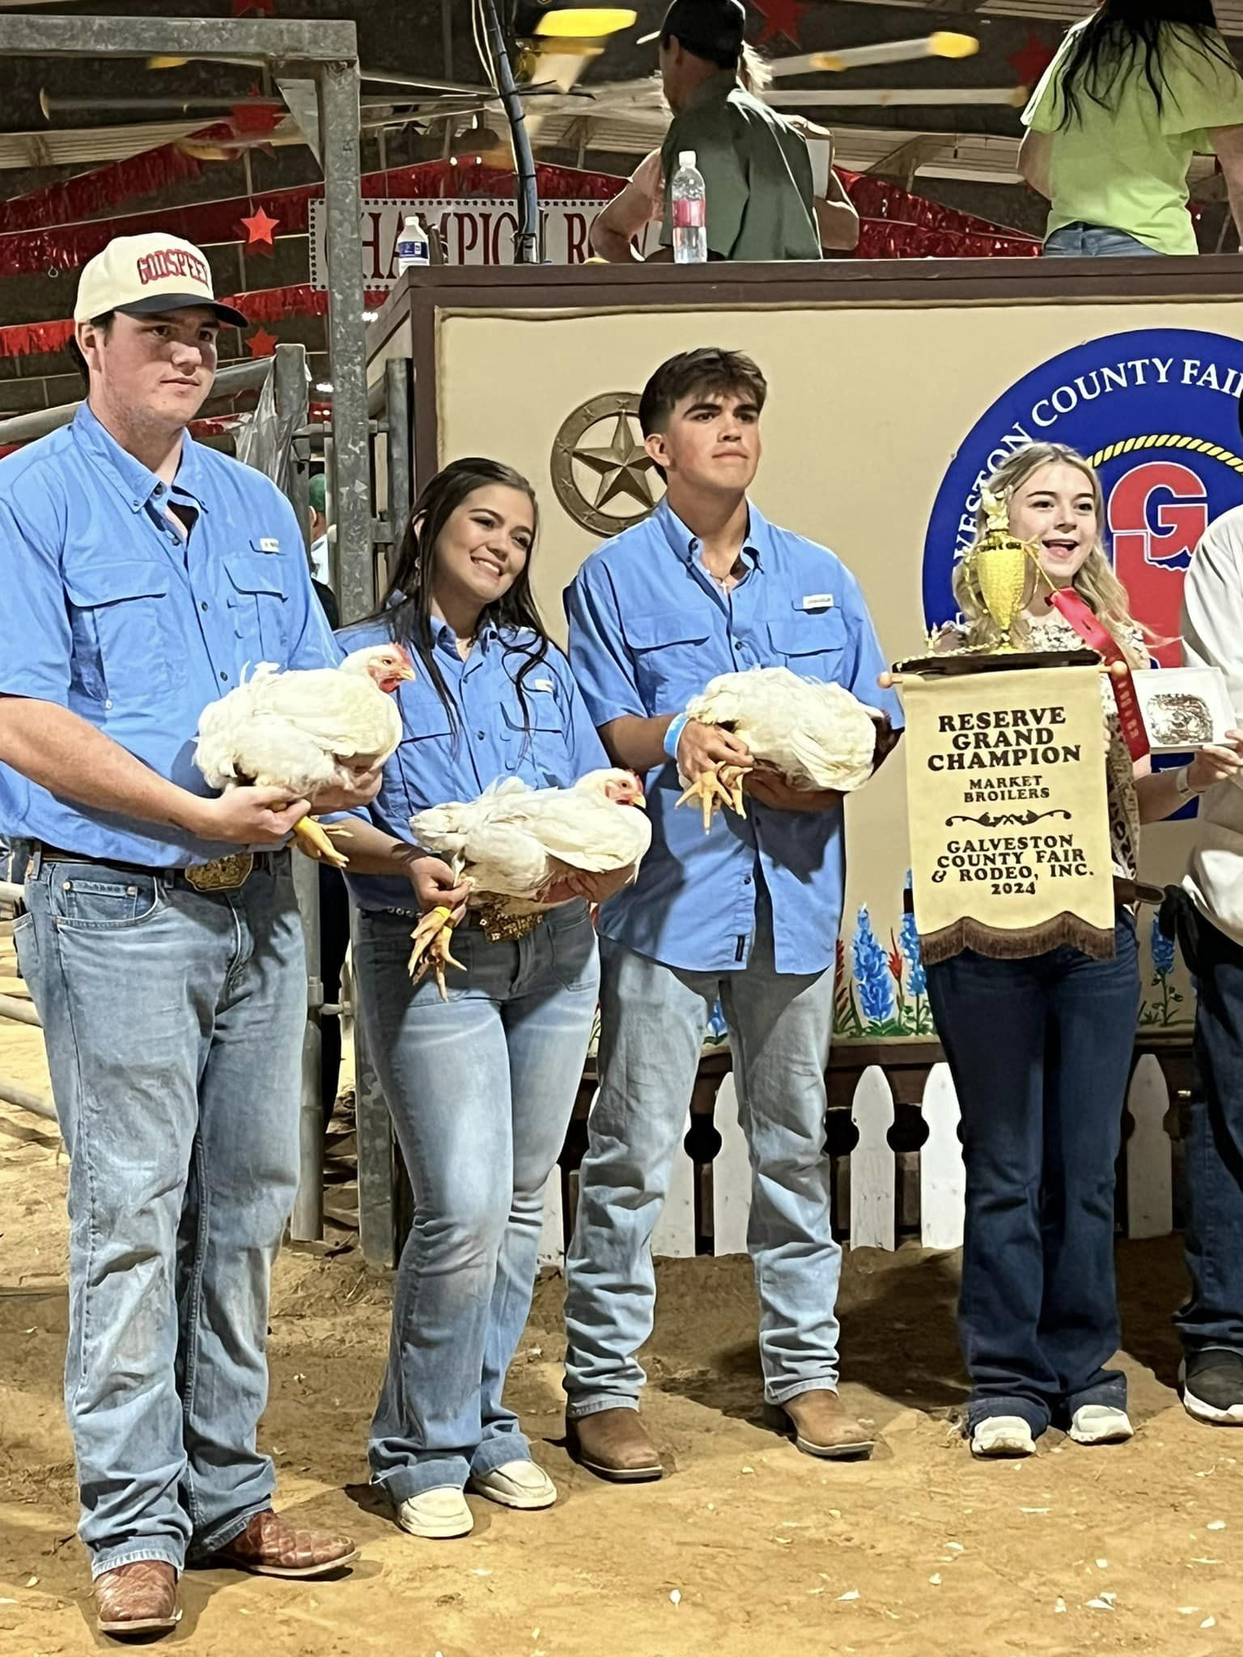
Poultry: Broilers & Turkeys
Timeframe: 6 – 12 weeks
Purchase Cost: purchase prices is usually approximately $1.75 per bird up to 100 birds and a minimum of 25 birds.
Feed Cost: $300/ pen
Contact: Mrs Ashcraft
Multiple feedings per day.
Stall is cleaned daily.
Shavings cost approximately $80.00+ per pen.
Entry Fees vary depending upon show.

Slide 17
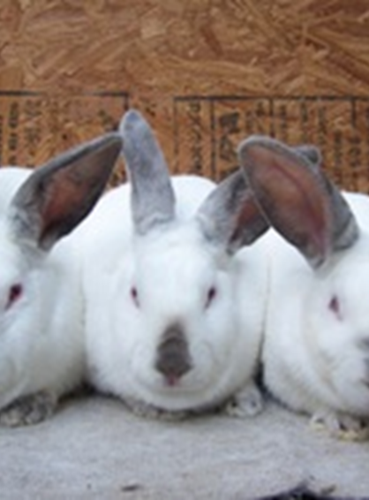
Rabbits
Timeframe: on going project
Student is responsible for finding their own housing. Rabbits are not housed at the TCISD Ag. Facility.
Purchase price of the animal is approximately $60.00+ per breeding rabbit. This project requires you to show the offspring of the breeding rabbits.
Feed Cost: $10/ month average
Contact: Ms. Griffis
Entry fees vary depending on show entered.

Slide 18
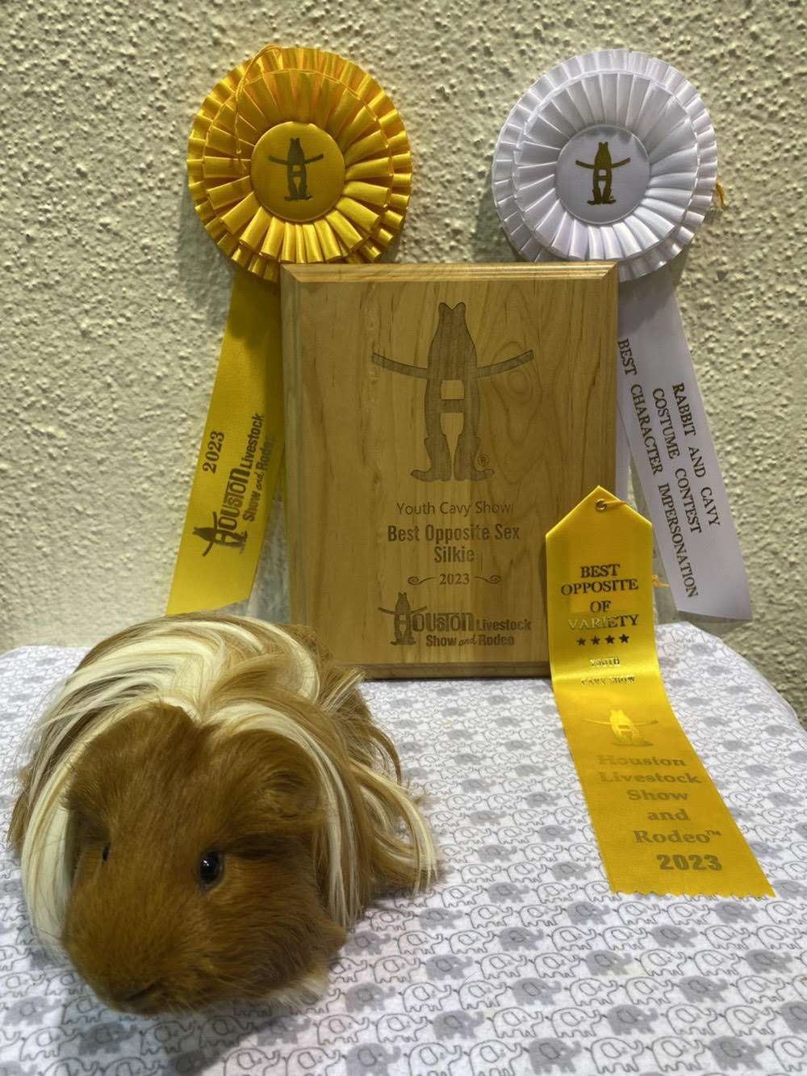
Cavies
Timeframe: on going project
Student is responsible for finding their own housing. Cavies are not housed at the TCISD Ag. Facility.
Purchase price of the animal is approximately $35.00+ per Cavies
Feed Cost: $10/ month average
Contact: Miss Griffis
Entry fees vary depending on
shows entered

Slide 19

Galveston County Fair and Rodeo
Date: Friday april 12-20, 2024
Show and Auction: Week Long
Entry Deadline: Remind will be sent out in advance for each species.

Slide 20
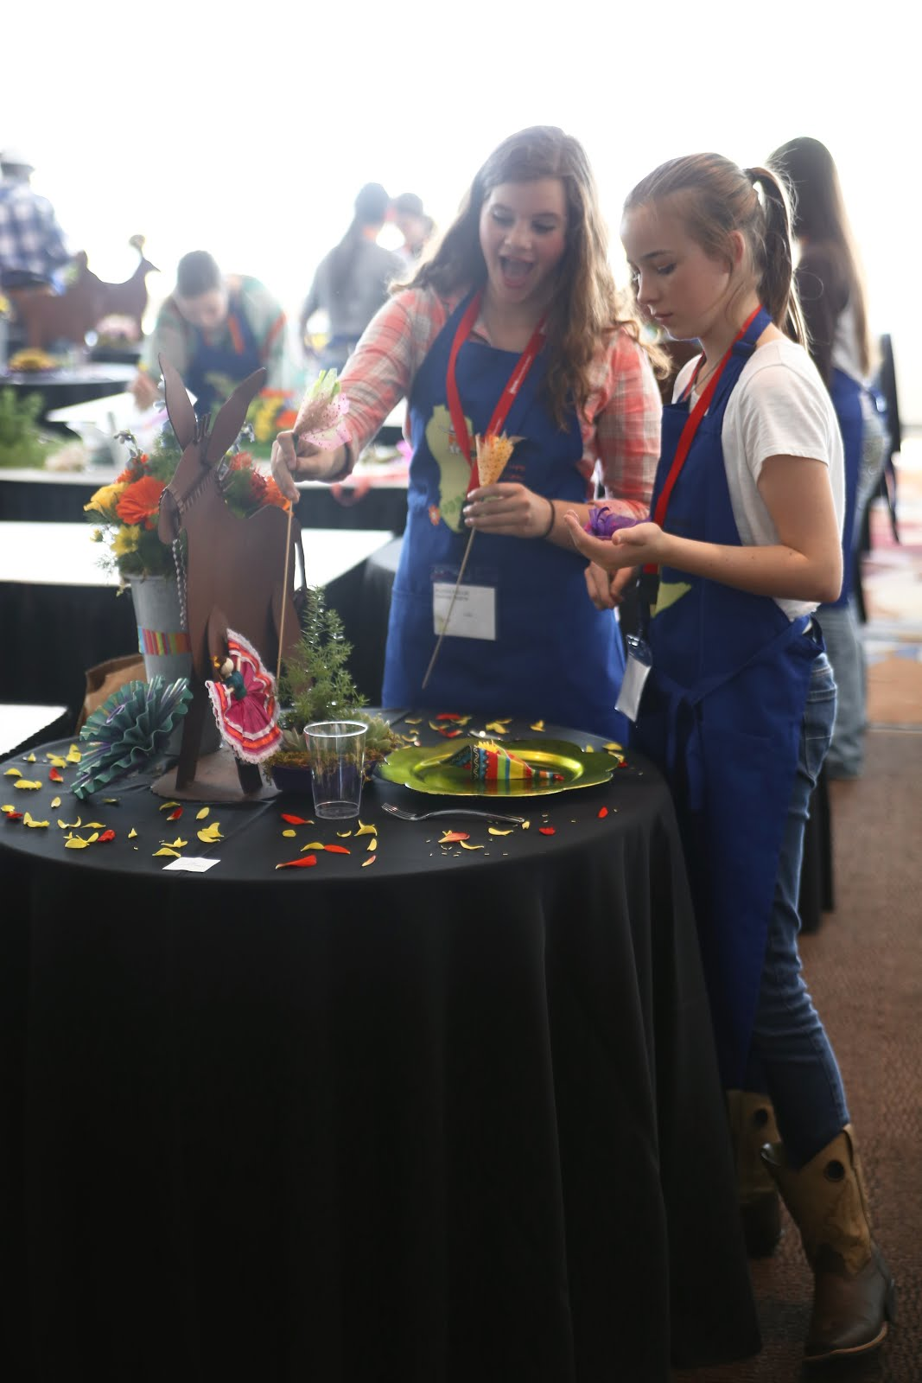
Horticulture
Opportunities for both GCFR and HLSR
Must be a paid FFA Member
Entry Fees and Deadlines vary per show
Contact: Ms. Richards

Slide 21
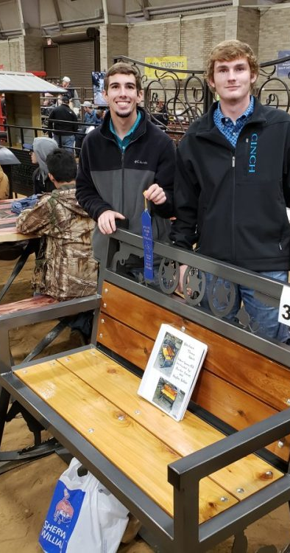
Ag. Mechanics
Opportunity at Galveston County Fair & Rodeo
Must be a paid FFA Member
Entry Fees vary
Build project from Wood or Metal
Project ideas: Trailers, Agriculture Equipment, Livestock and Wildlife Equipment, Home/Woodwork Projects, Tractor Restoration, Horse Equipment

Slide 22
CDEs
(Career Development Events)
Ms. Westhoff | Ms. Richards | Mrs. Ashcraft
Land Marketing Plan | Entomology Floriculture | Vet Med Livestock
**Subject to change**
Why Compete in CDEs?

Slide 23

Community Service Activities
Current “Living to Serve” Community service projects will be posted online and in the Reminds

Slide 24

Fundraisers
  Top Salesman Award will account ALL Fundraisers
  If selling as a family, will divide total number by amount of FFA members in the family
  will be posted in the remind when going on and on social medias

Slide 25
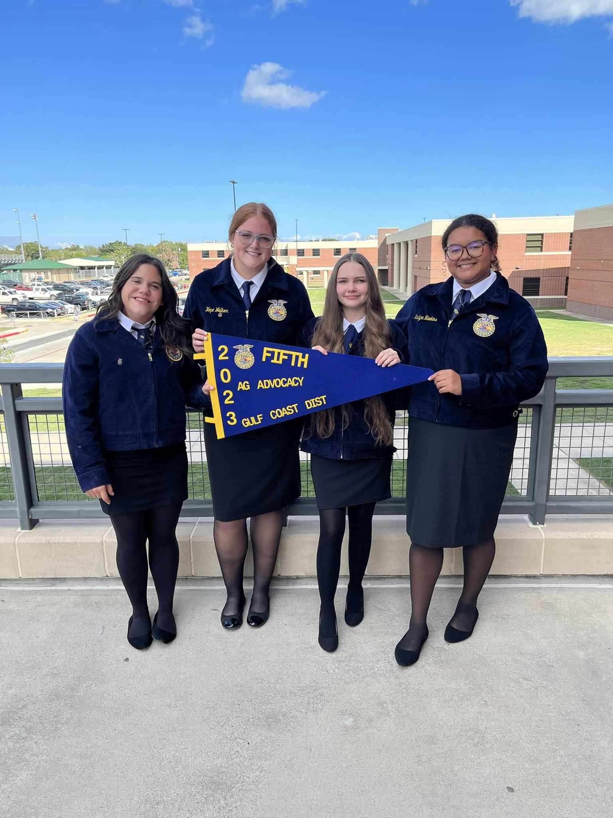
FFA Official Dress
$60 - $85 – Official FFA Jacket (standard or tailored)
$13 - 25 Tie or Scarf (depends on style)
If you can not afford a jacket but want to participate, contact your teacher about The Gift of Blue
https://shopffa.org/cat/2/OFFICIAL-DRESS/

Slide 26

End of the Year Banquet
Time: May 2023 (Date TBD)
Place: in years past in the Wings of Heritage Room
Receive recognition for accomplishments
Awards
Senior Speeches, cords, and shooting team stoles
Food

Slide 27

Remind
Texas City FFA Remind
Text 81010 with message @tcffa20
FFA Trailer Request
@ffatrai
Texas City FFA Alumni Remind
Text 81010 with message @tcffaalumn
Livestock Species
must get with the Advisor over the species to get added

Slide 28
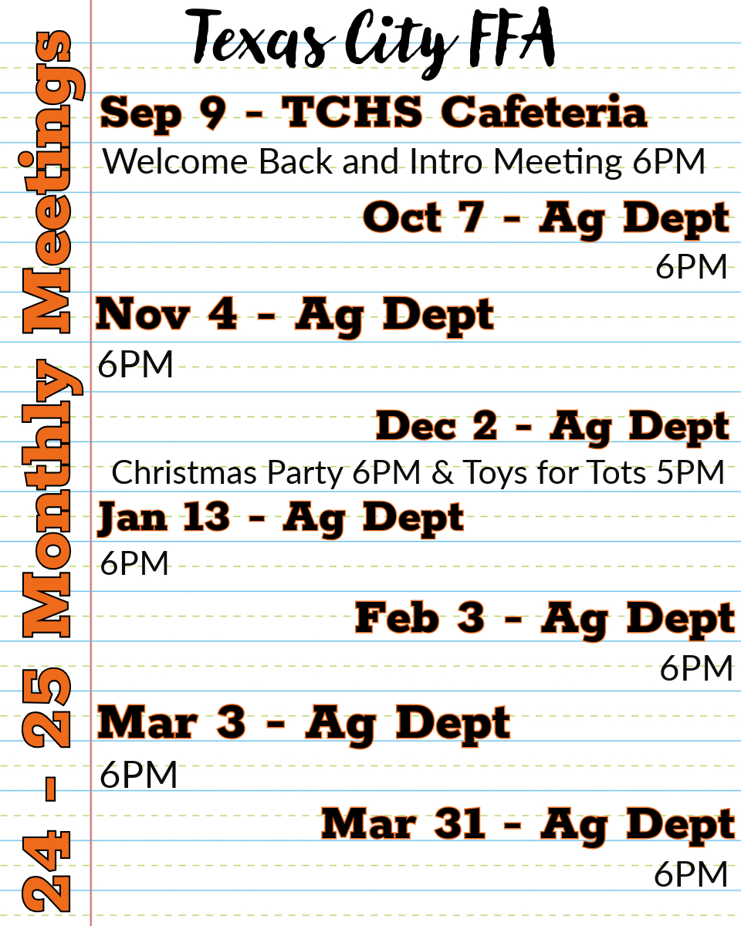

Slide 29
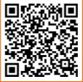
Upcoming Important Dates
Calendar

